Slide 1
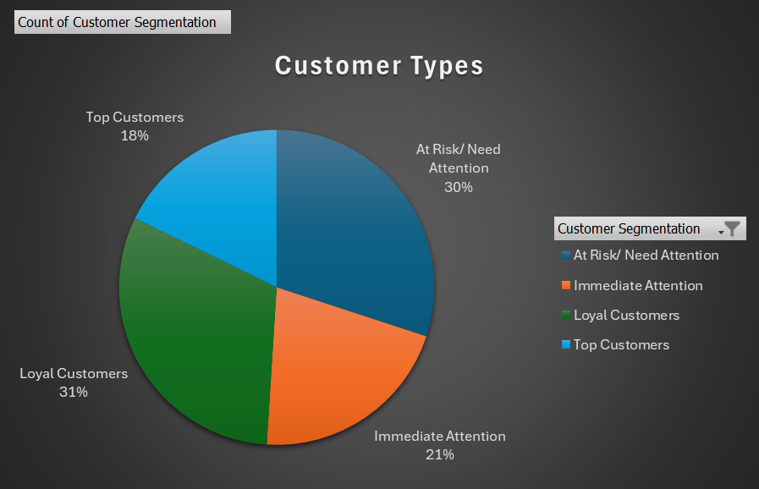
Customer Segmentation
Technique:
By scoring our customers by Recency, Frequency and Monetary, we have 5 major observations.
18%
TOP CUSTOMER SEGMENT:
On an average customers have purchased 8 times in the evaluation period, spending an average of $7,200 over 10 days.
51%
AT RISK/ IMMEDIATE ATTENTION SEGMENT:
At risk customers are spending $353 and purchased only 3 times in 150 days.
At Risk/ Need Attention 30.04%
Immediate Attention 20.96%
Loyal Customers 31.23%
Top Customers 17.76%

